Slide 1
DEMAND AND SUPPLY

Slide 2
Introduction
Supply and demand are the forces that make market economies work.
They determine the quantity of each good produced and the price at which it is sold. If you want to know how any event or policy will affect the economy, you must think first about how it will affect supply and demand.
The terms supply and demand refer to the behavior of people as they interact with one another in competitive markets.

Slide 3
What is a market?
A market is a group of buyers and sellers of a particular good or service. The buyers as a group determine the demand for the product, and the sellers as a group determine the supply of the product.
Sometimes markets are highly organized, such as the markets for many agricultural commodities. In these markets, buyers and sellers meet at a specific time and place, where an auctioneer helps set prices and arrange sales.
More often, markets are less organized. For example, consider the market for ice cream in a particular town. Buyers of ice cream do not meet together at any one time. The sellers of ice cream are in different locations and offer somewhat different products. There is no auctioneer calling out the price of ice cream. Each seller posts a price for an ice-cream cone, and each buyer decides how much ice cream to buy at each store.

Slide 4
What is competition?
Economists use the term competitive market to describe a market in which there are so many buyers and so many sellers that each has a negligible impact on the market price. Each seller of ice cream has limited control over the price because other sellers are offering similar products.
A perfectly competitive market must have two characteristics: (1) the goods offered for sale are all exactly the same, and (2) the buyers and sellers are so numerous that no single buyer or seller has any influence over the market price.
Because buyers and sellers in perfectly competitive markets must accept the price the market determines, they are said to be price takers. At the market price, buyers can buy all they want, and sellers can sell all they want.

Slide 5
Not all goods and services, however, are sold in perfectly competitive markets. Some markets have only one seller, and this seller sets the price. Such a seller is called a monopoly.
Despite the diversity of market types we find in the world, assuming perfect competition is a useful simplification and, therefore, a natural place to start. Perfectly competitive markets are the easiest to analyze because everyone participating in the market takes the price as given by market conditions. Moreover, because some degree of competition is present in most markets, many of the lessons that we learn by studying supply and demand under perfect competition apply in more complicated markets as well.

Slide 6
Demand
The quantity demanded of any good is the amount of the good that buyers are willing and able to purchase. Many things influence demand but price plays a central role.
Other things equal, the quantity demanded of a good falls when the price of the good rises. The inverse relationship between price and quantity demanded is true for most goods in the economy that economists call it the law of demand.

Slide 7
Market demand curves
We sum the individual demand curves horizontally to obtain the market demand curve. That is, to find the total quantity demanded at any price, we add the individual quantities, which are found on the horizontal axis of the individual demand curves.
Because we are interested in analyzing how markets function, we work most often with the market demand curve.
The market demand curve shows how the total quantity demanded of a good varies as the price of the good varies, while all the other factors that affect how much consumers want to buy are held constant.

Slide 8
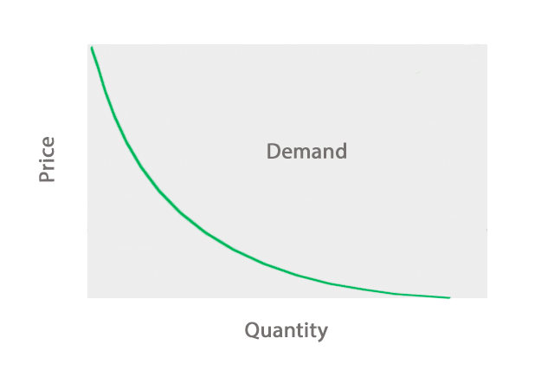
Demand Curve

Slide 9
Factors shifting the demand curve
Because the market demand curve holds other things constant, it need not be stable over time. If something happens to alter the quantity demanded at any given price, the demand curve shifts resulting in either increase (shift to the right) or decrease in demand (shift to the left).
Income
Prices of related goods-When a fall in the price of one good reduces the demand for another good, the two goods are called substitutes. When a fall in the price of one good raises the demand for another good, the two goods are called complements.

Slide 10
Expectations Your expectations about the future may affect your demand for a good or service today. For example, if you expect to earn a higher income next month, you may choose to save less now and spend more of your current income buying ice cream. As another example, if you expect the price of ice cream to fall tomorrow, you may be less willing to buy an ice-cream cone at today’s price.
Number of Buyers In addition to the preceding factors, which influence the behavior of individual buyers, market demand depends on the number of these buyers.
Shifts vs movement along the demand curve

Slide 11
Supply
The quantity supplied of any good or service is the amount that sellers are willing and able to sell.
When the price of ice cream is high, selling ice cream is profitable, and so the quantity supplied is large. By contrast, when the price of ice cream is low, the business is less profitable, and so sellers produce less ice cream.
This relationship between price and quantity supplied is called the law of supply: Other things equal, when the price of a good rises, the quantity supplied of the good also rises, and when the price falls, the quantity supplied falls as well.

Slide 12
Market supply curves
Just as market demand is the sum of the demands of all buyers, market supply is the sum of the supplies of all sellers.
As with demand curves, we sum the individual supply curves horizontally to obtain the market supply curve. That is, to find the total quantity supplied at any price, we add the individual quantities, which are found on the horizontal axis of the individual supply curves.
The supply curve slopes upward because, other things equal, a higher price means a greater quantity supplied.

Slide 13
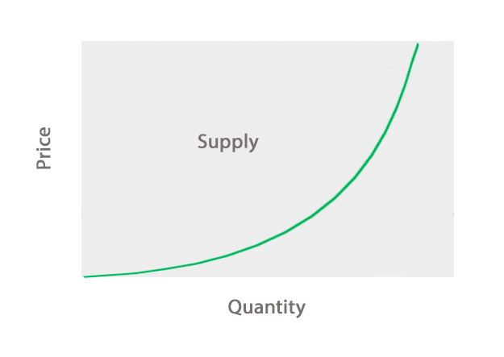
Supply curve

Slide 14
Shifts in the supply curve
Because the market supply curve holds other things constant, the curve shifts when one of the factors changes resulting in either increase (shift to the right) or decrease in supply (shift to the left).
Input prices
Technology
Expectations
Number of sellers

Slide 15
Demand and Supply
We now combine market demand and supply curves to see how they determine the price and quantity of a good sold in a market.
There is one point at which the supply and demand curves intersect. This point is called the market’s equilibrium. The price at this intersection is called the equilibrium price, and the quantity is called the equilibrium quantity.
The equilibrium price is sometimes called the market-clearing price because, at this price, everyone in the market has been satisfied: Buyers have bought all they want to buy, and sellers have sold all they want to sell.
The actions of buyers and sellers naturally move markets toward the equilibrium of supply and demand. (i.e there is no excess supply or demand)

Slide 16
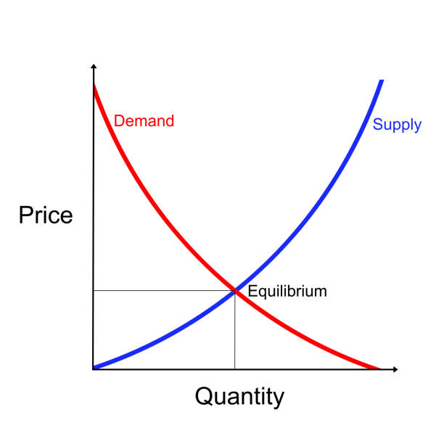
Equilibrium in the market

Slide 17
Understanding changes to the equilibrium
Shift of the demand curve (case of increase in demand)
Shift of the supply curve (case of decrease in supply)
Simultaneous shifts

Slide 18
Normal and inferior goods
Normal goods are those goods for which the demand rises as consumer income rises.
An inferior good is a good whose demand decreases when consumer income rises (or demand increases when consumer income decreases)

Slide 19
THANK YOU

